Slide 1
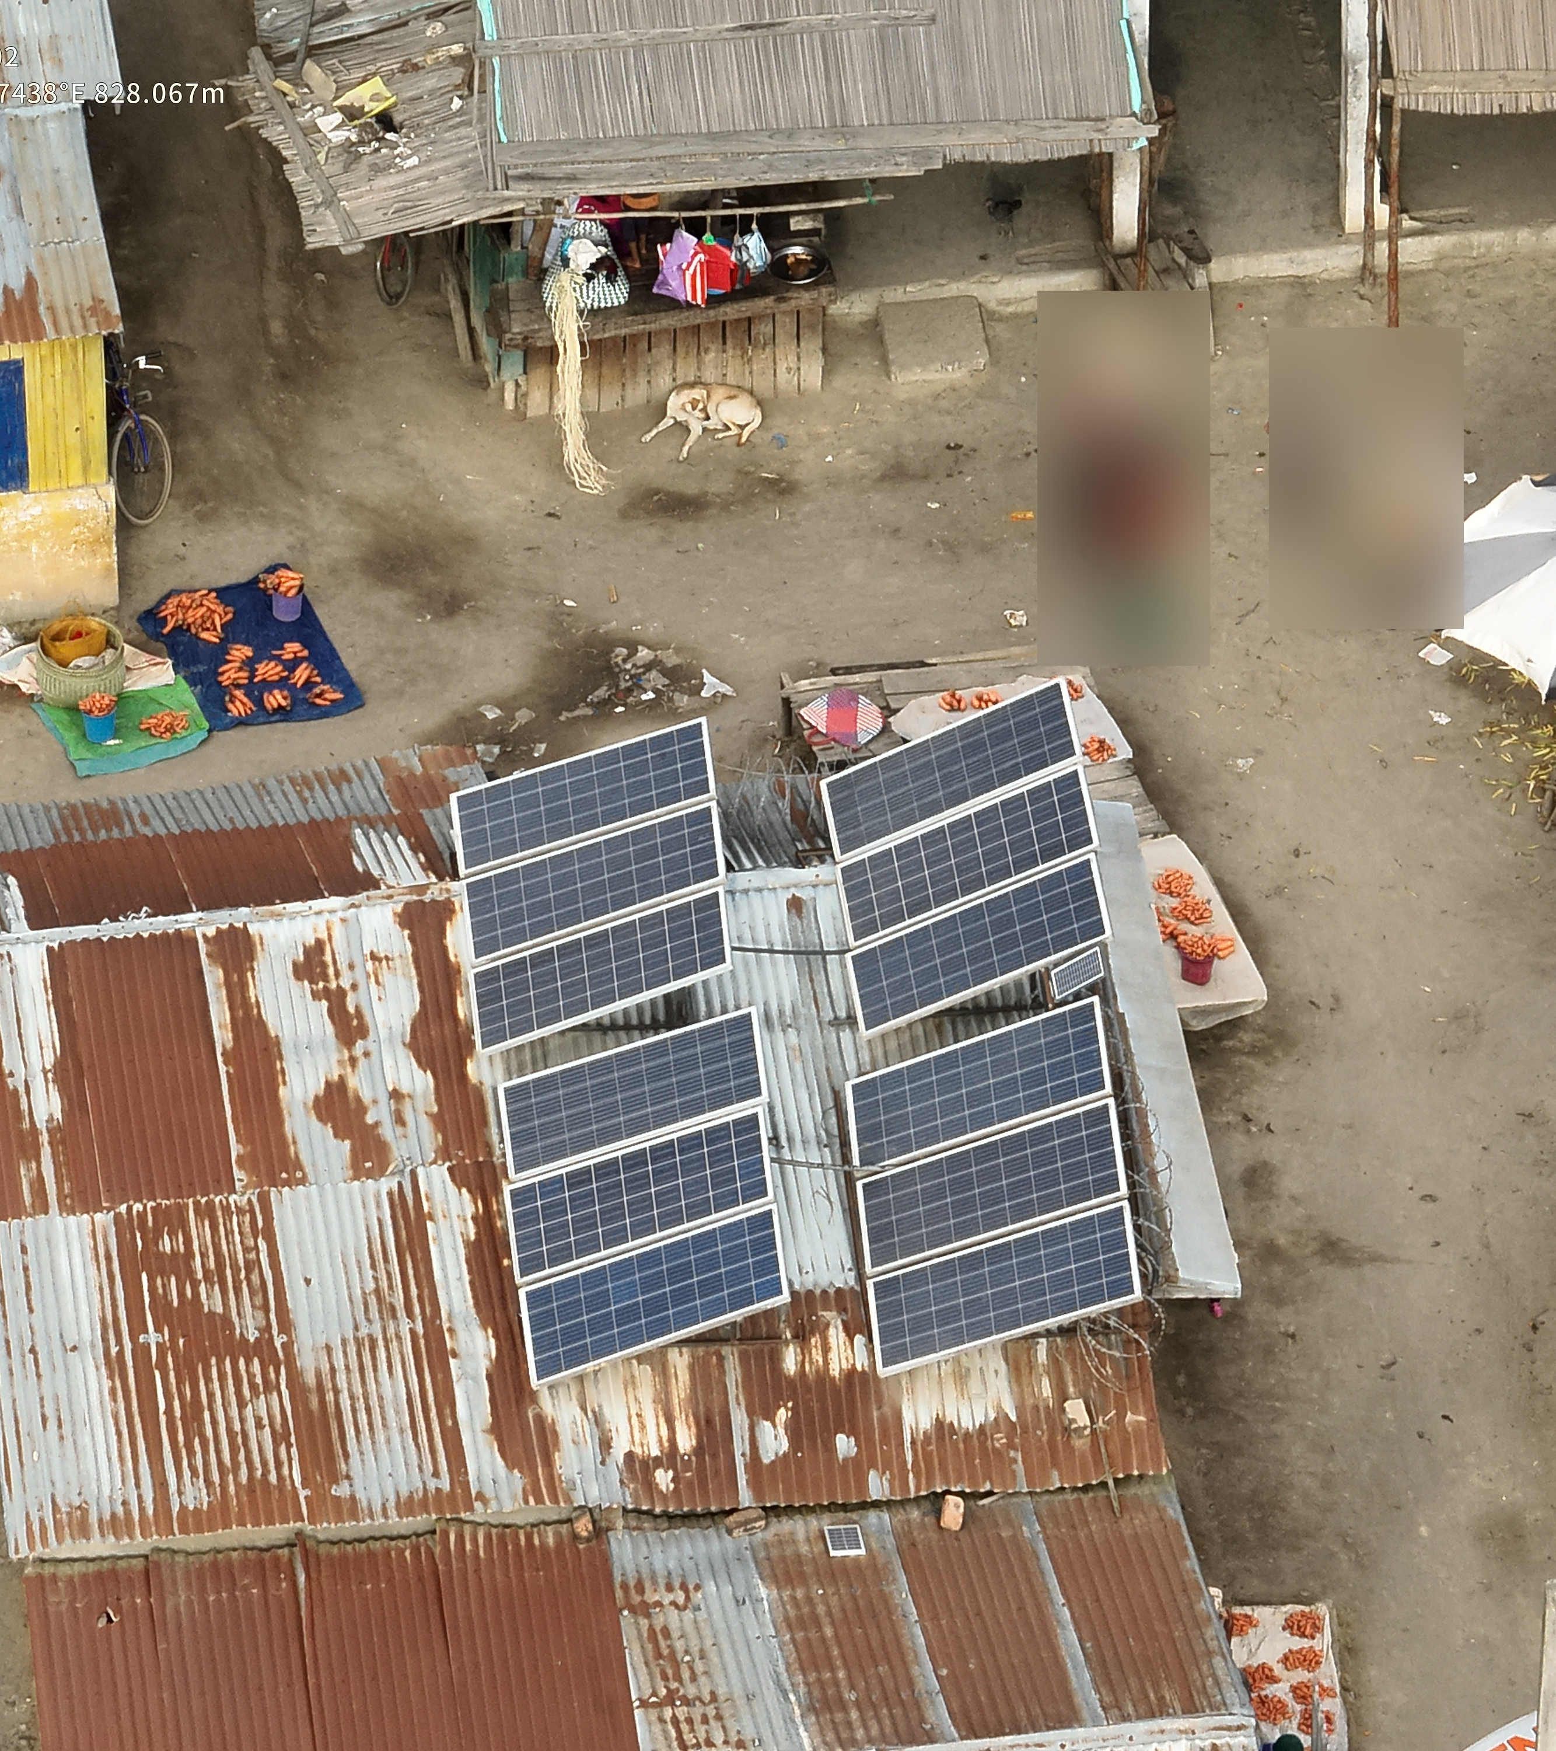
Counting Photovoltaic and Solar Panels from Aerial Imagery
Complements of Machine Learning 24/25
Lacuna Solar Survey Challenge
Hugo Veríssimo 124348
João Cardoso 50750

Slide 2

contents
Project Overview
Data Analysis
Deep Learning Models
Results Analysis

Slide 3
Project Overview

Slide 4
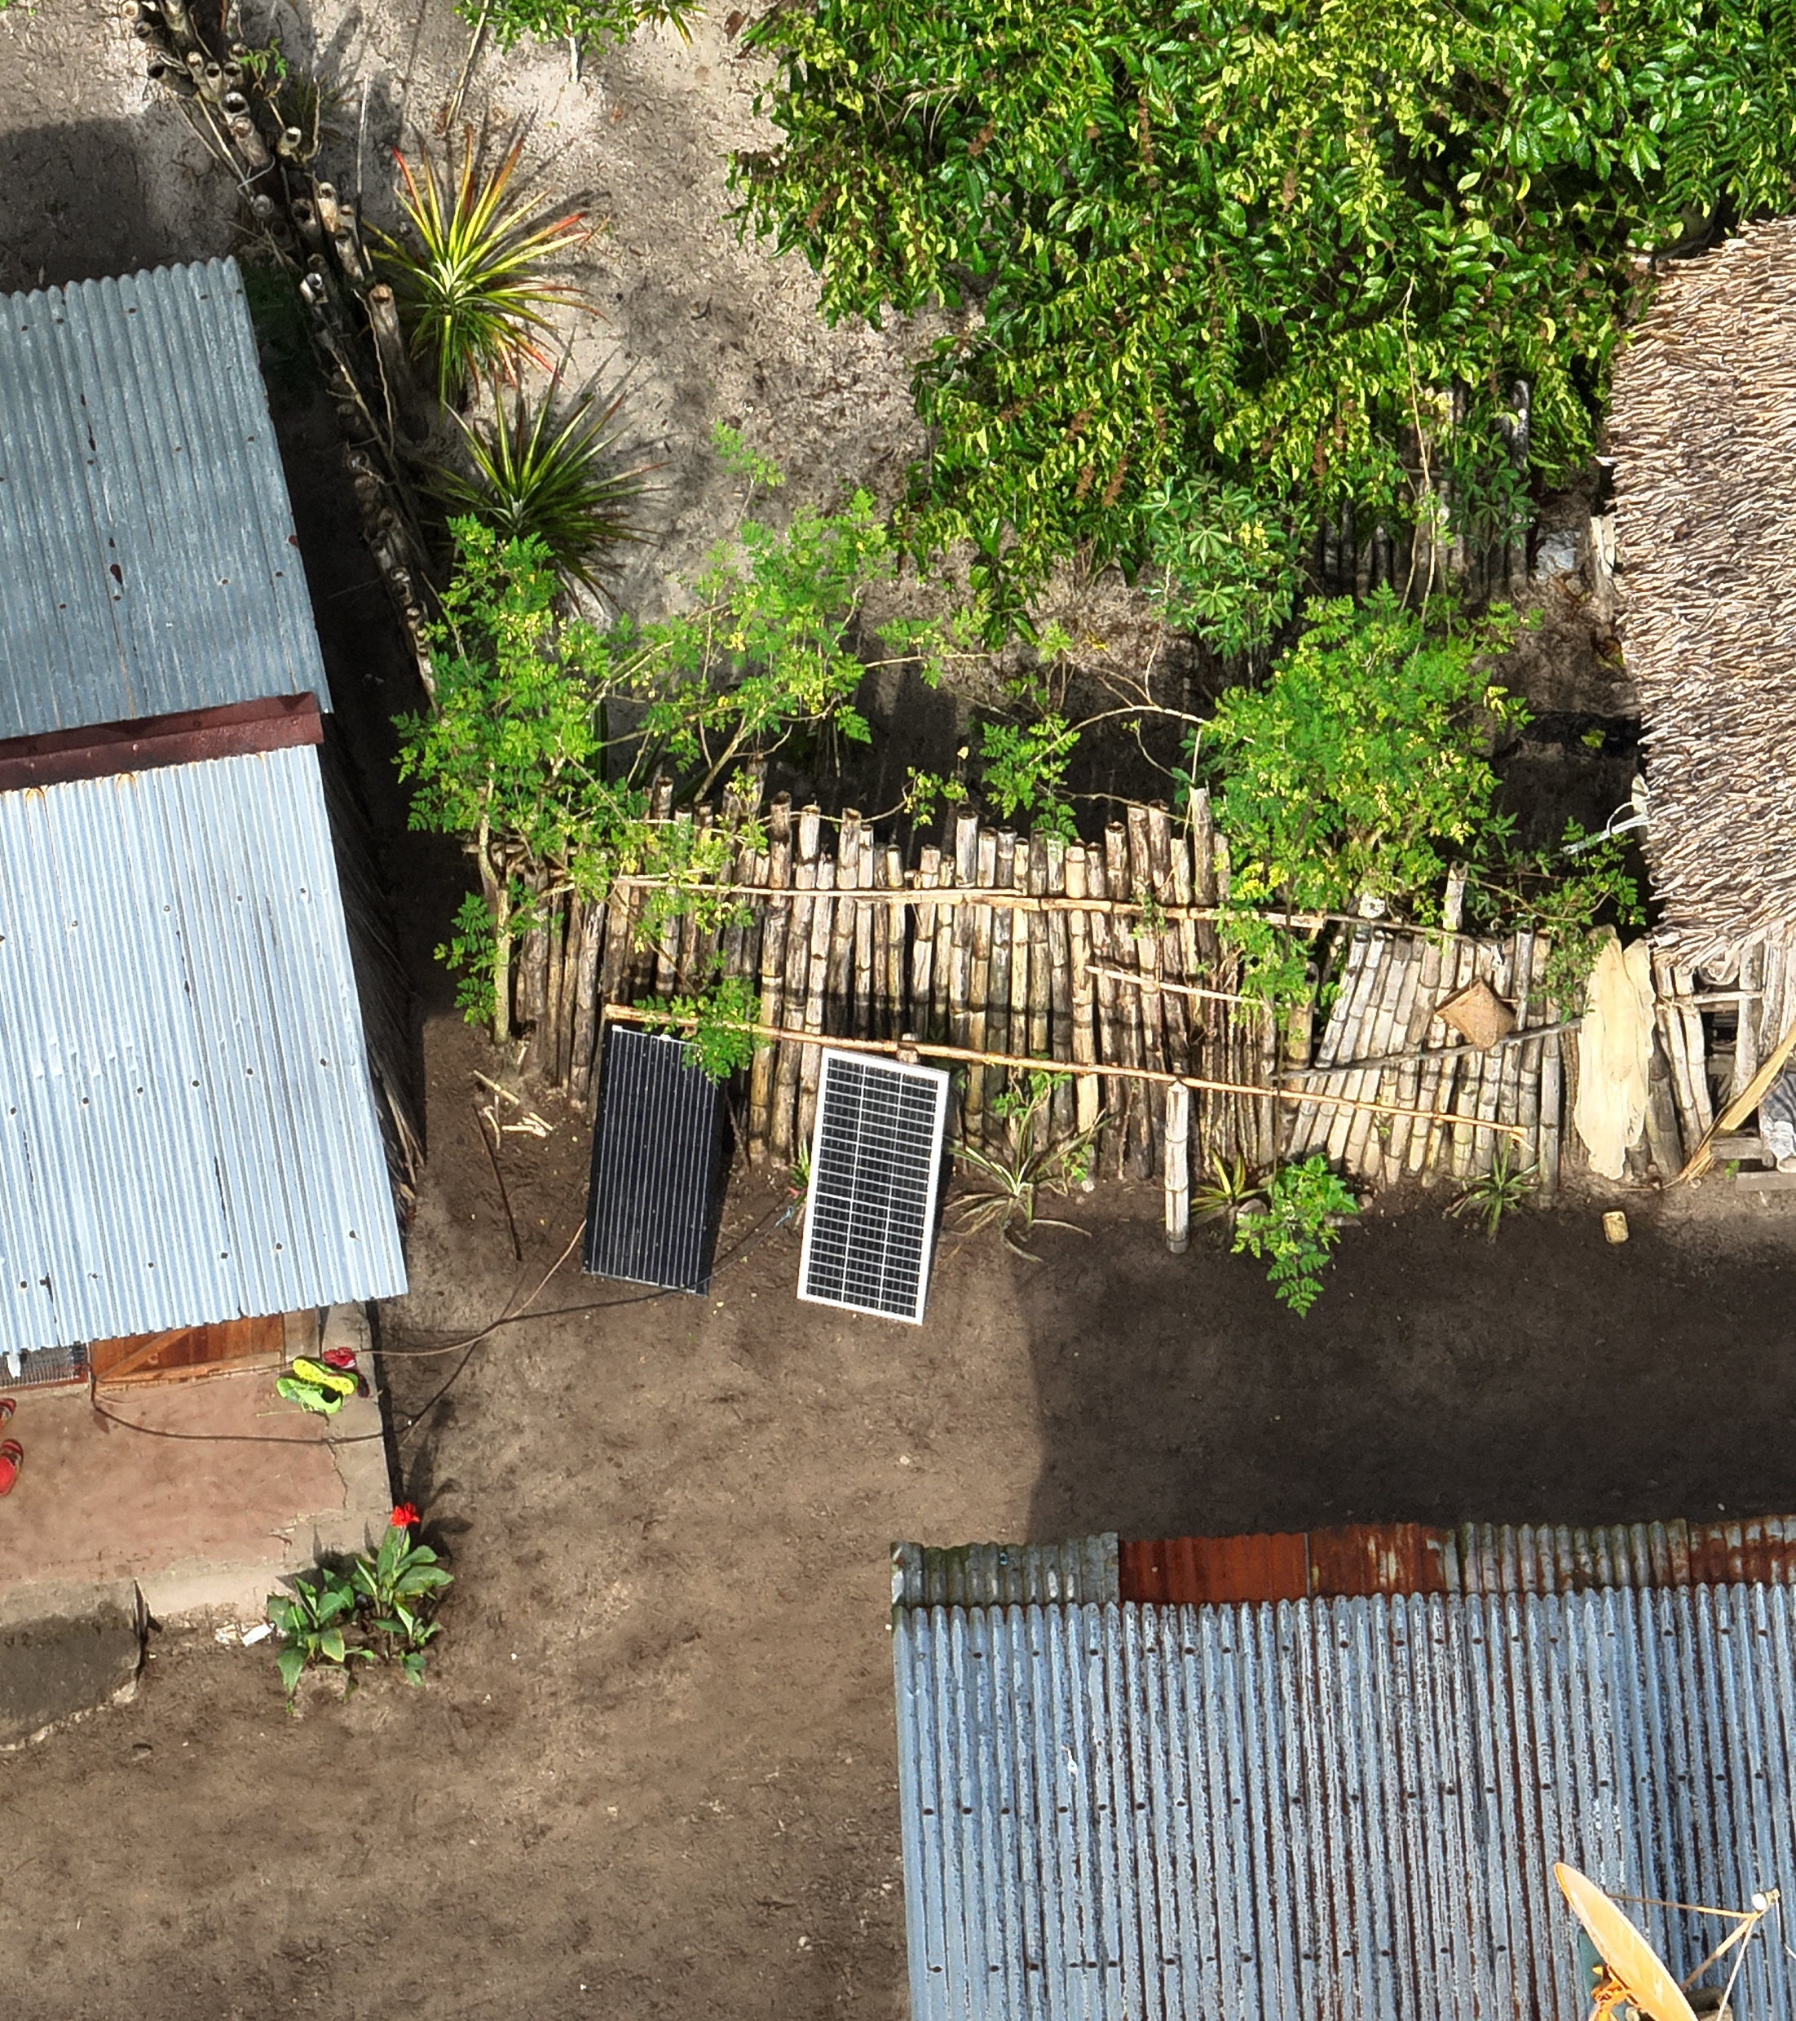
The problem
Context:
Develop DL models as part of a challenge in the Zindi platform.
From aerial imagery (drone and satellite):
Count thermal solar panels
Count photovoltaic panels
Why?
Useful for estimating power demand in the grid and develop proper infrastructure.

Slide 5
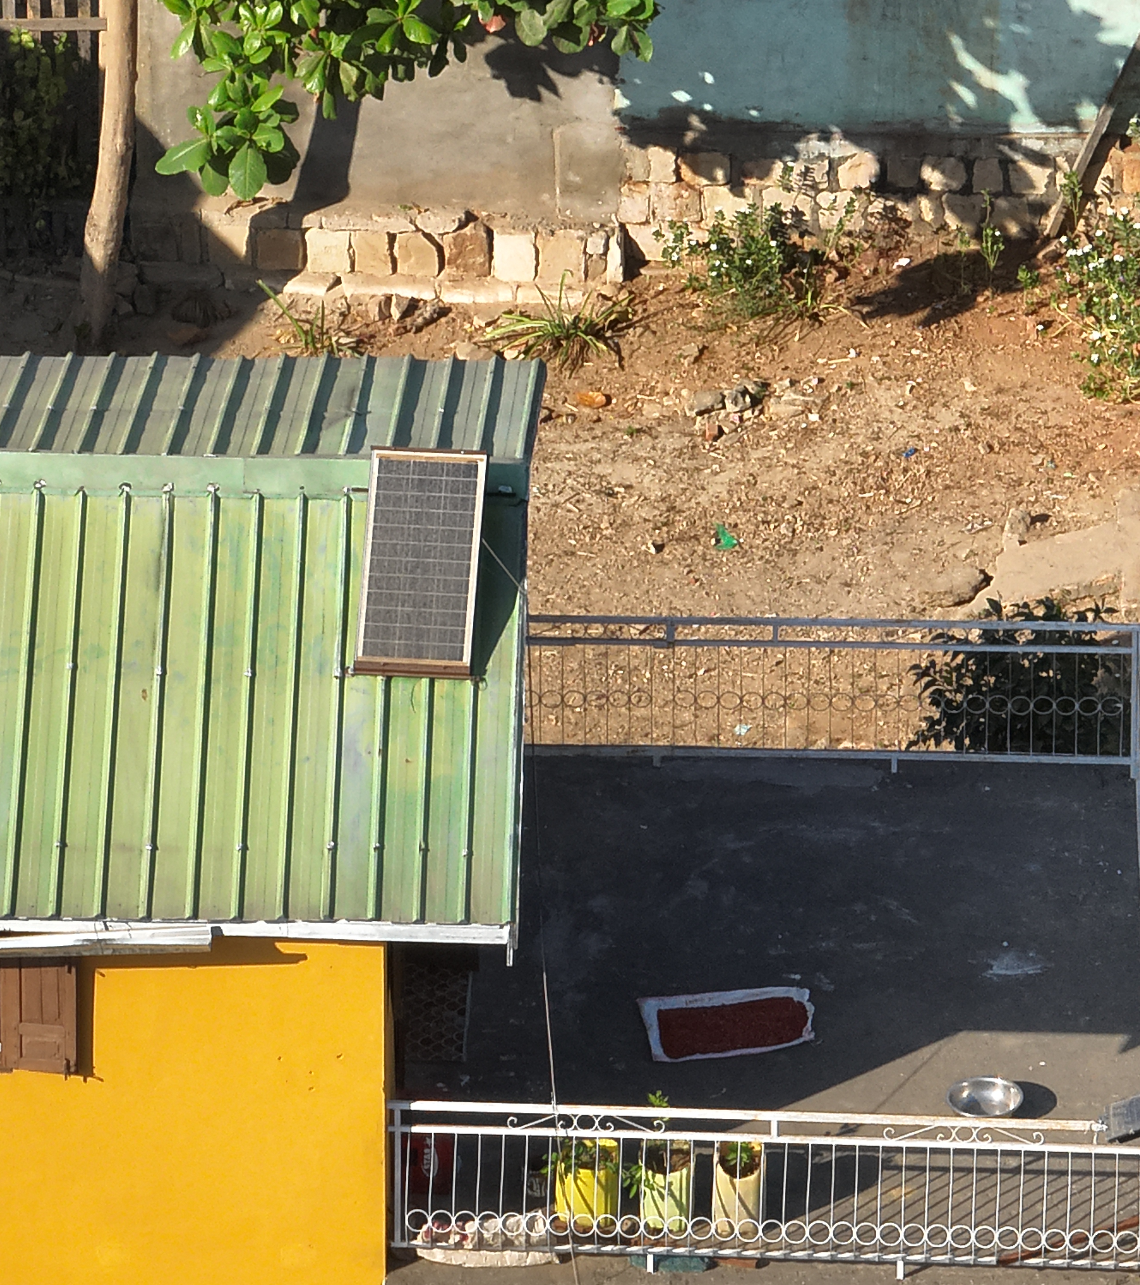
State of the art
Different approaches depending on the purpose:
Fast and swift models for quick image recognition, specialized in drone or satellite imagery
Multistage models for large data analysis (e.g., countrywide)
Highly accurate models for panel maintenance
Three main techniques for image detection:
Image-based regression
Object Detection
Instance segmentation

Slide 6
Data analysis

Slide 7
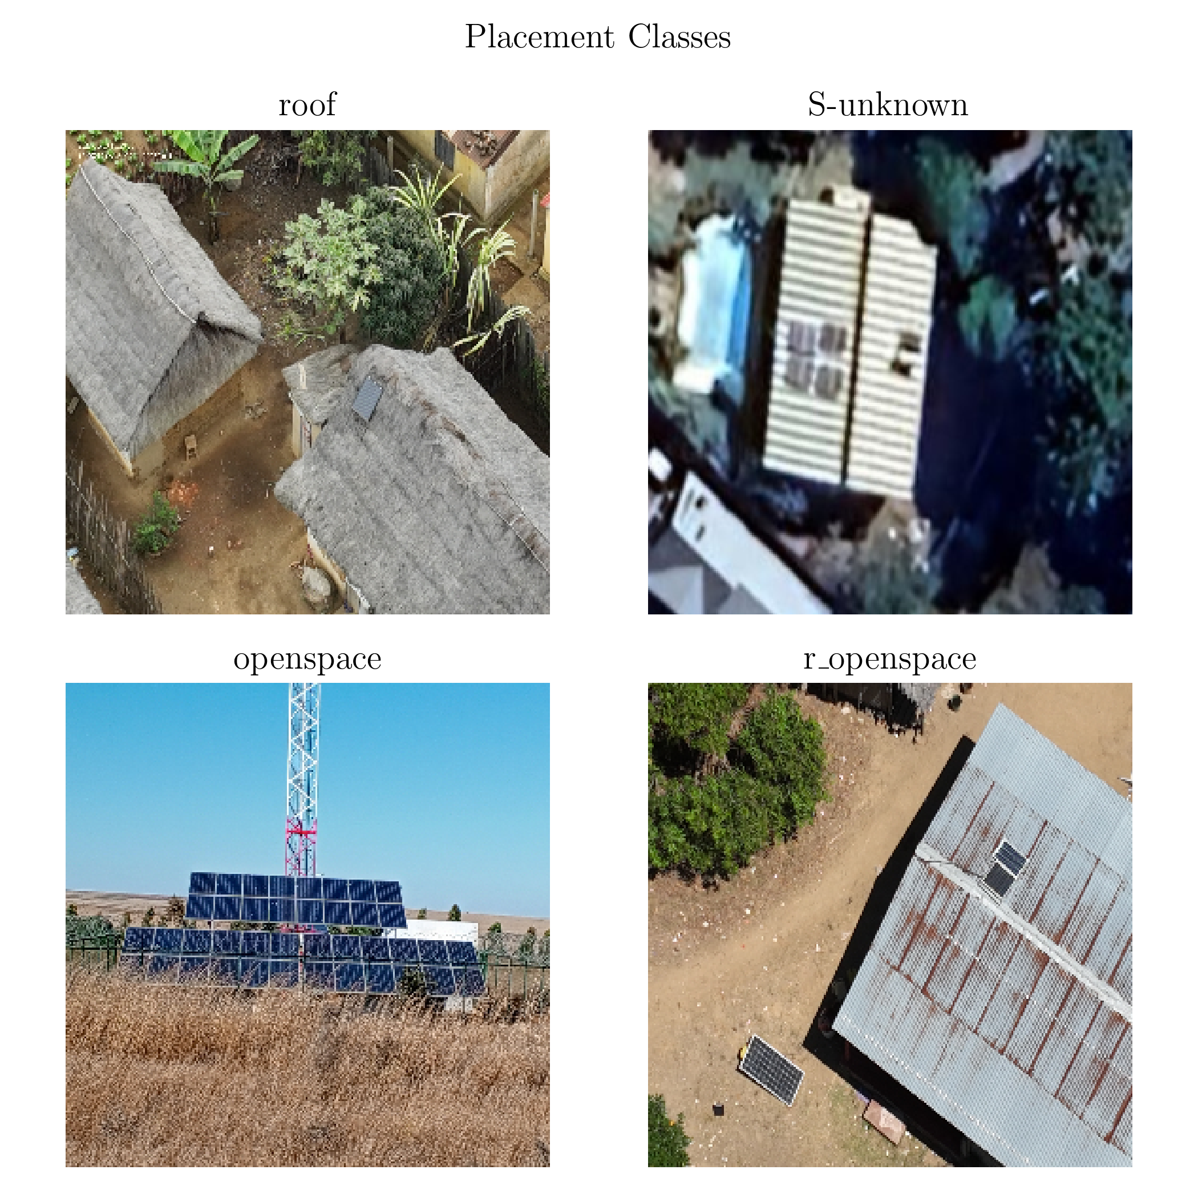
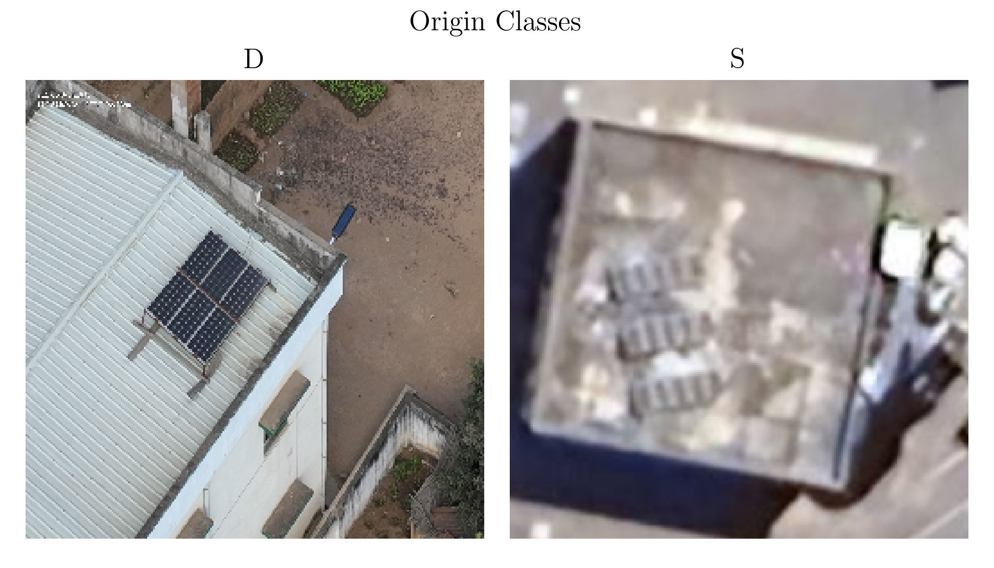
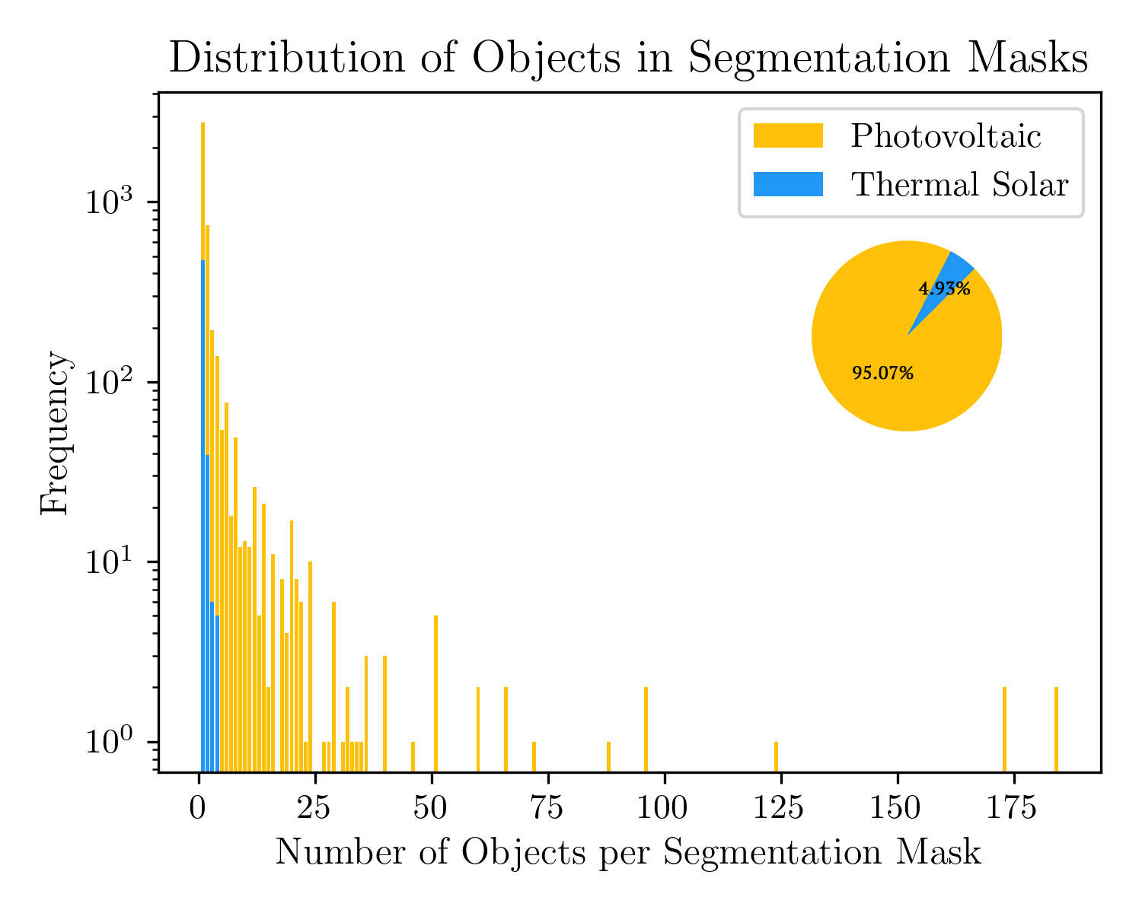
Raw data
4419 images (75/25 split)
For each training image:
Segmentation masks for panel groups
Panel count per group
Metadata

Slide 8
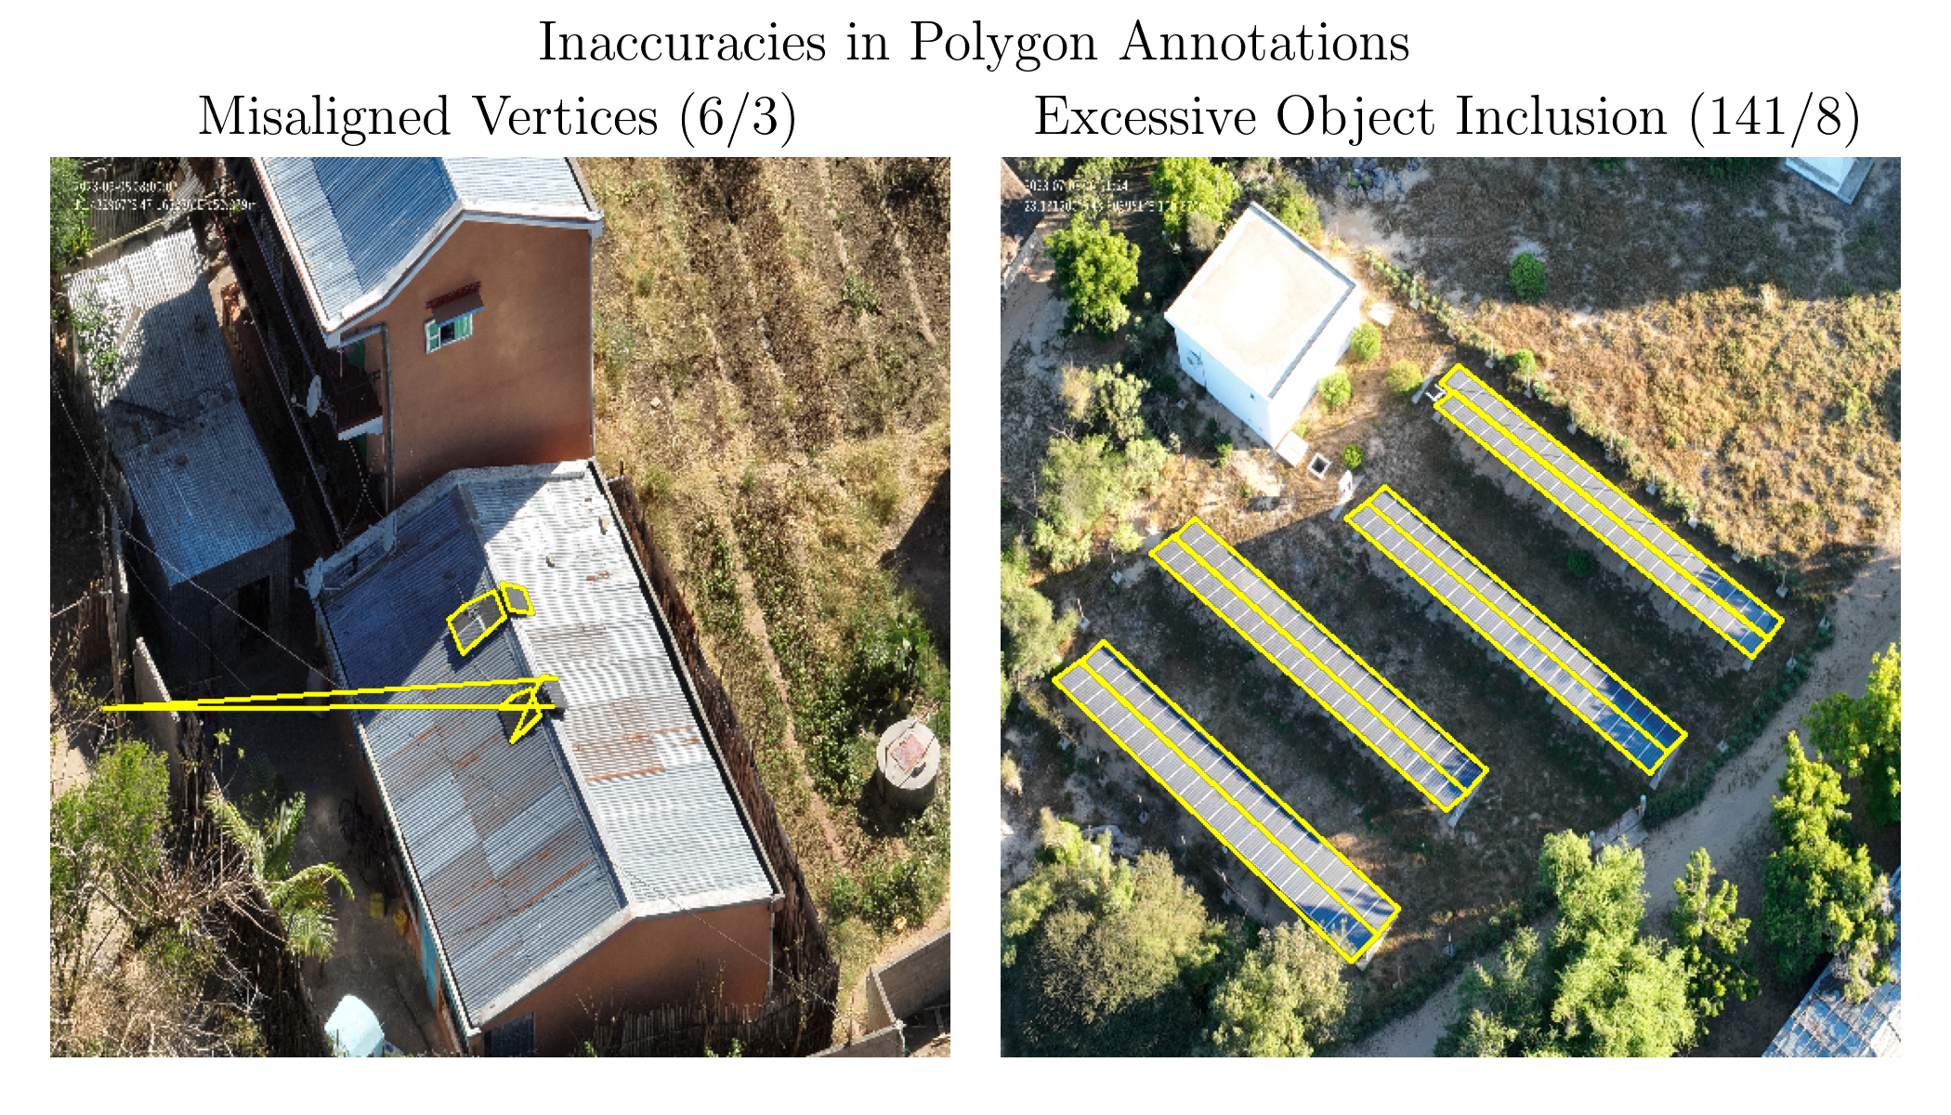
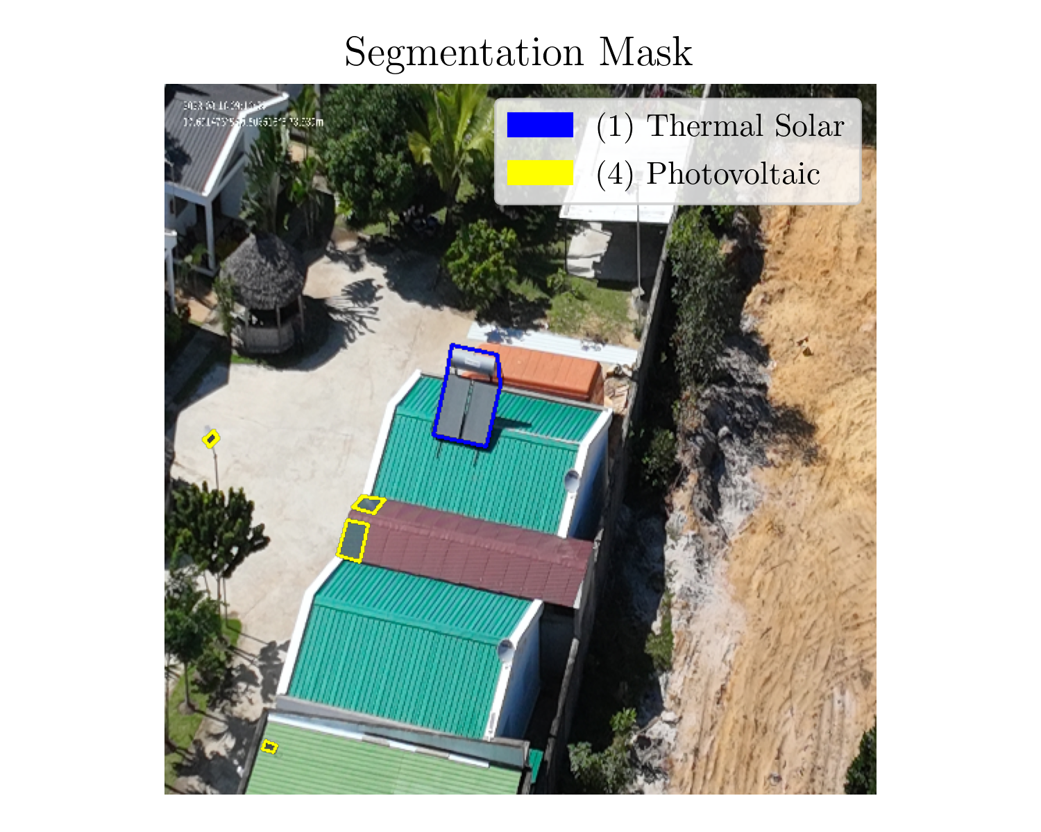
Preprocessing
Grouped all polygons belonging to the same image into one record
Fixed or remove innacurate polygons
Resized images to 512 x 512
Readjusted polygons to fit resized images

Slide 9
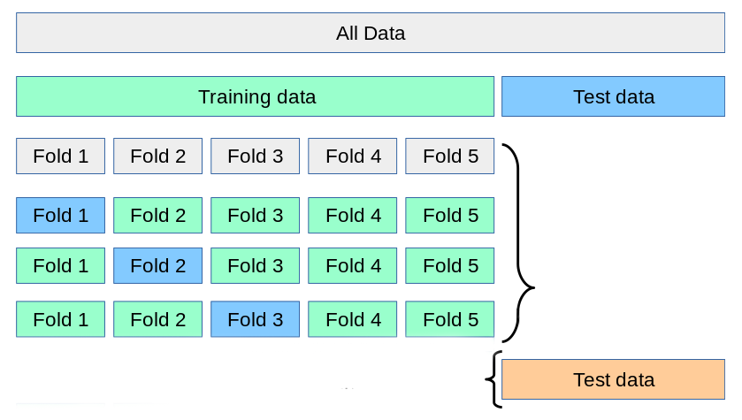
METHODOLOGY
with augmentation:
Flip and Rotate
Gaussian Blur
CLAHE
...

Slide 10
Deep learning models

Slide 11
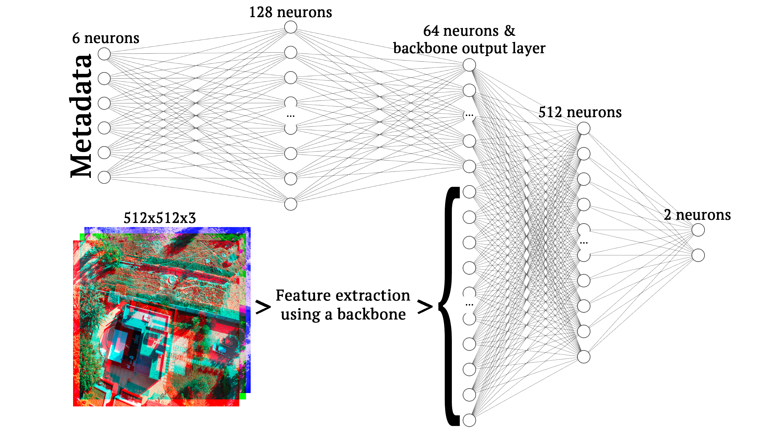
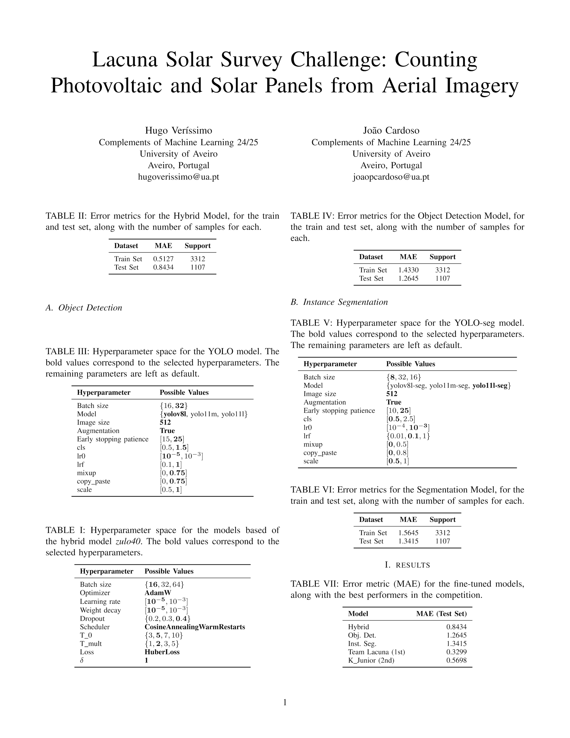
Image-based Regression
Tested backbones:
DenseNet121, EfficientNetv2B3 and ResNet101
Hyperparameter search space

Slide 12
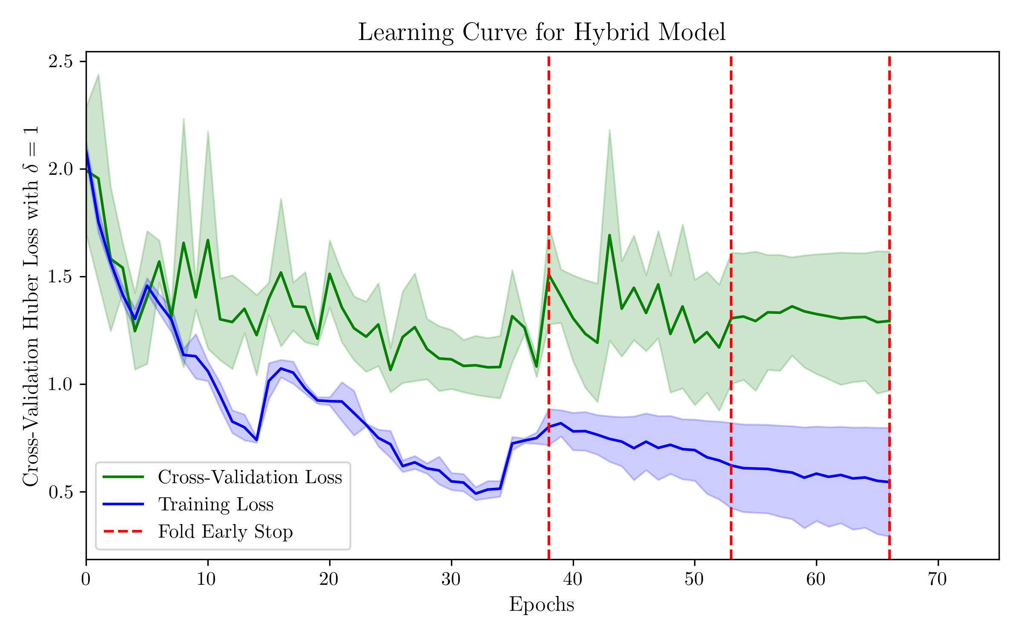
Image-based Regression - results
Error metrics

Slide 13
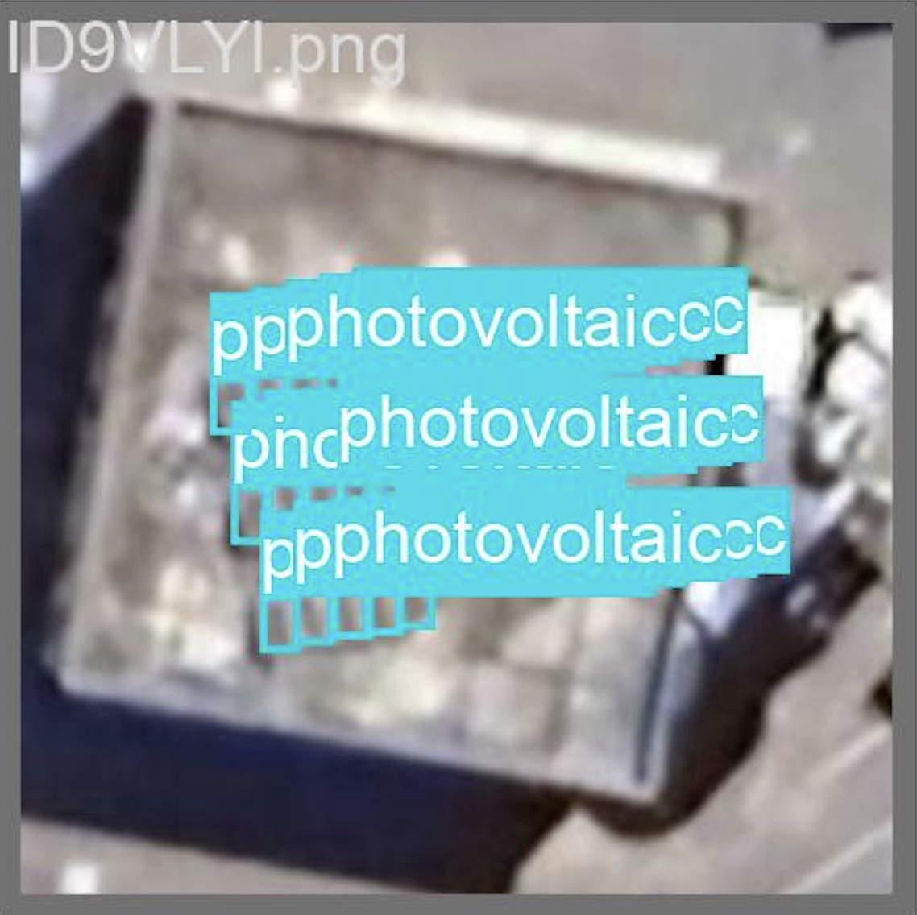
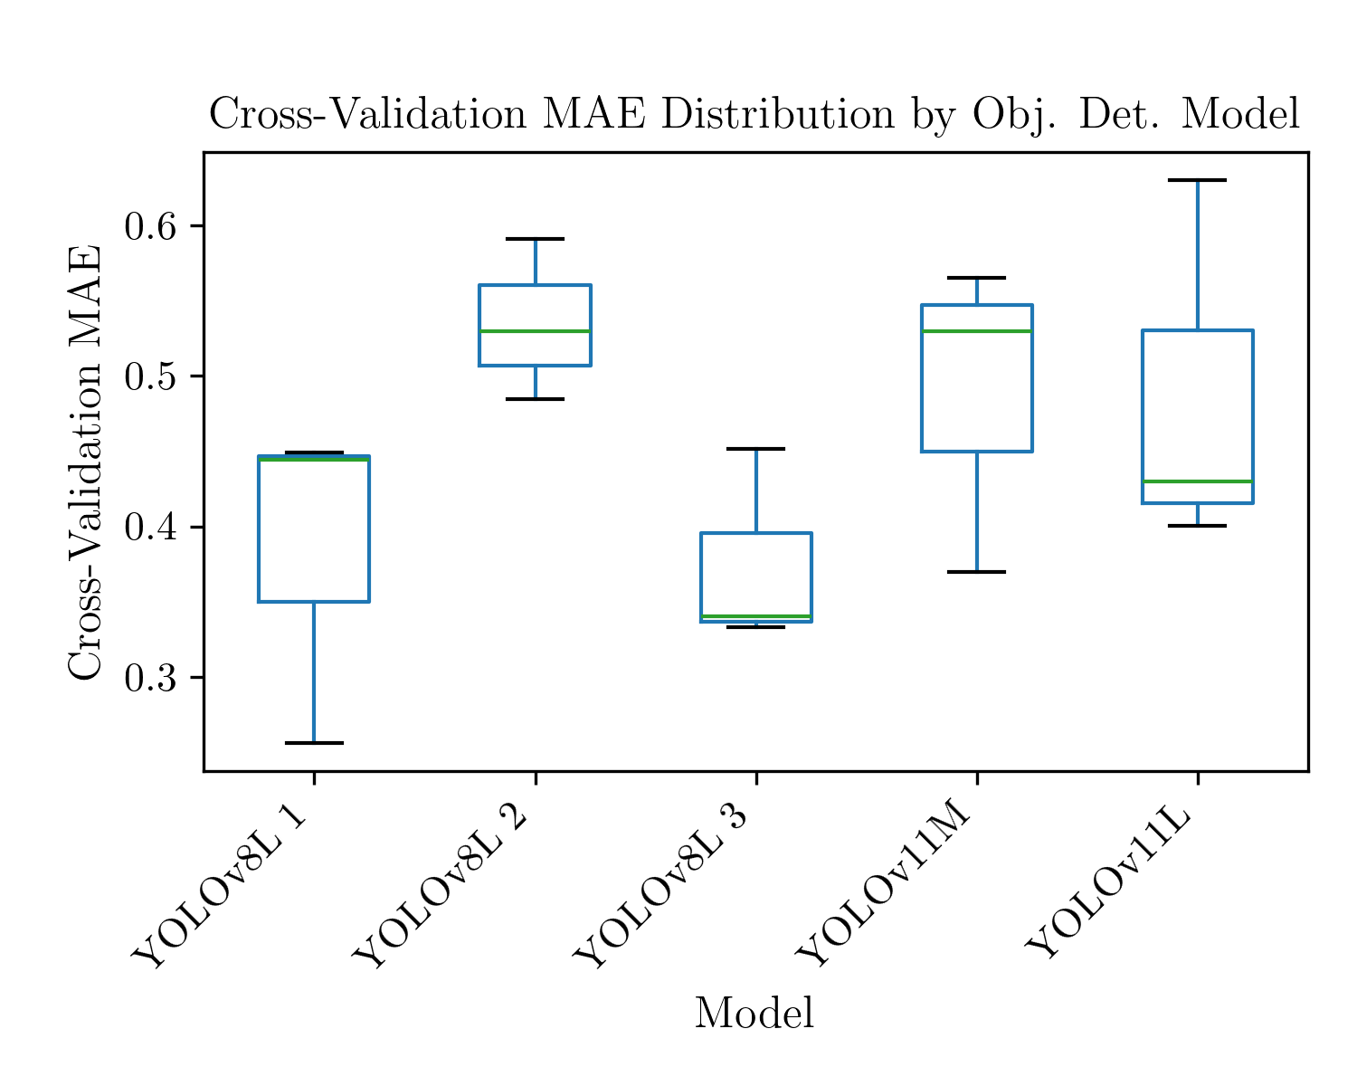
Object detection
Due to poor performance, polygons spanning multiple panels were manually redrawn to isolate single panels. Since this wasn't done for all images, around 40% of the training set was discarded.
Hyperparameter search space

Slide 14
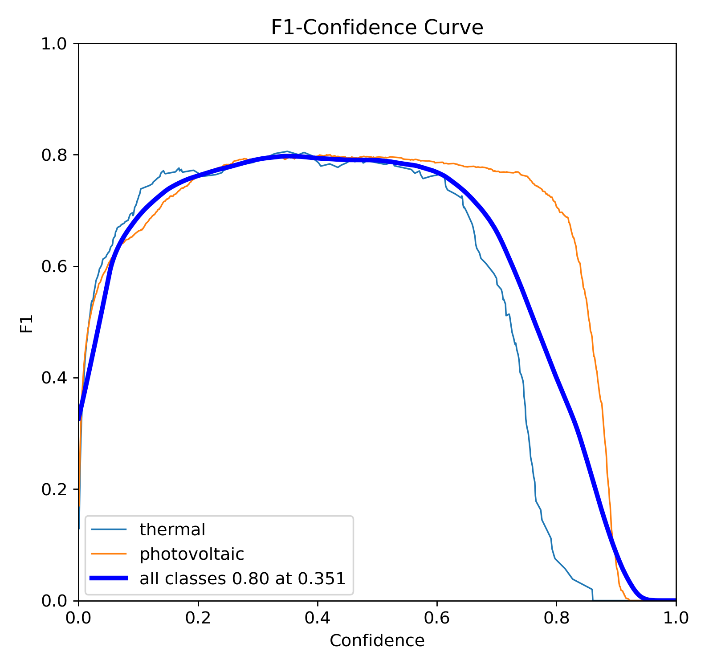
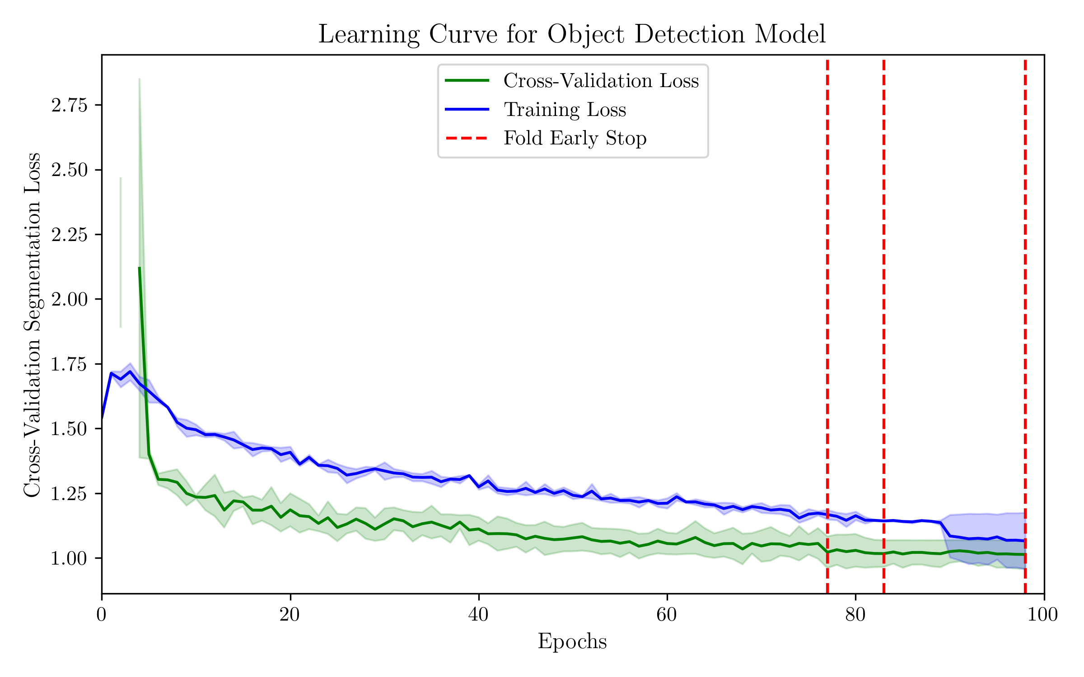
Object detection - results
Error metrics

Slide 15
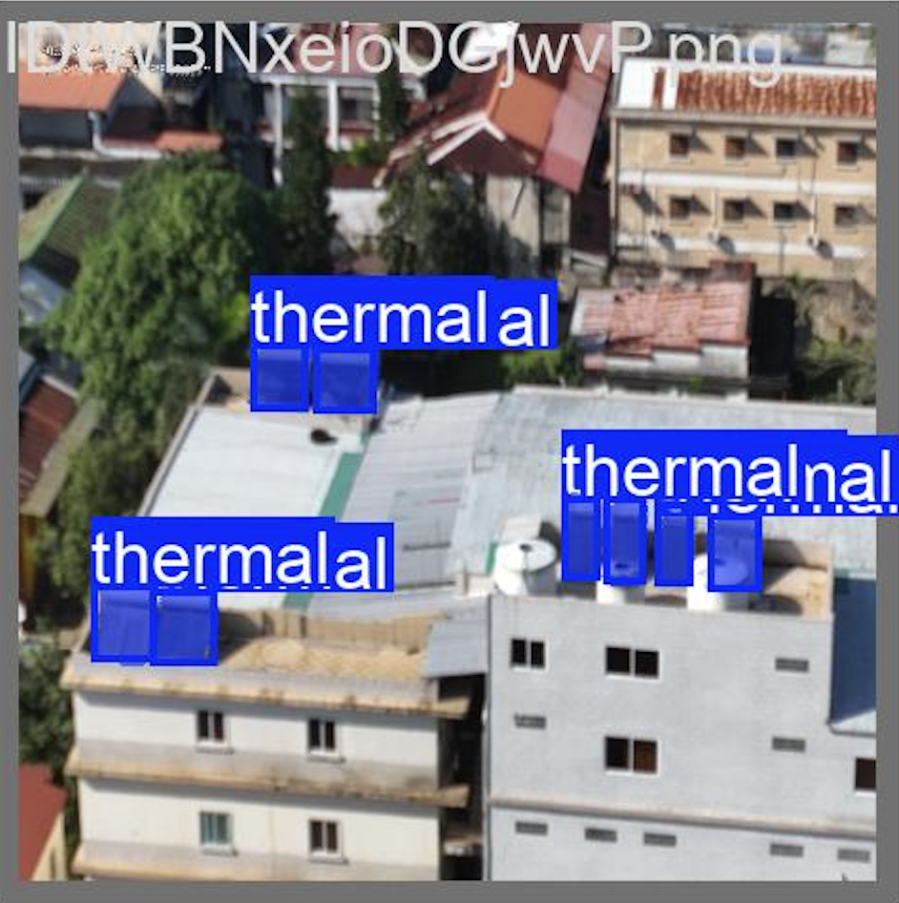
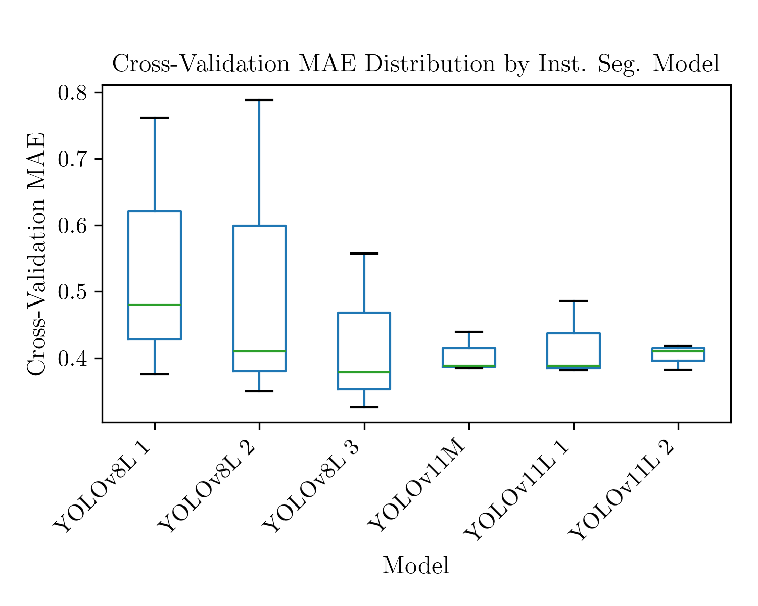
Instance segmentation
Due to poor performance, the revised polygons were reused, also without the 40% of training images that had been discarded.
Hyperparameter search space

Slide 16
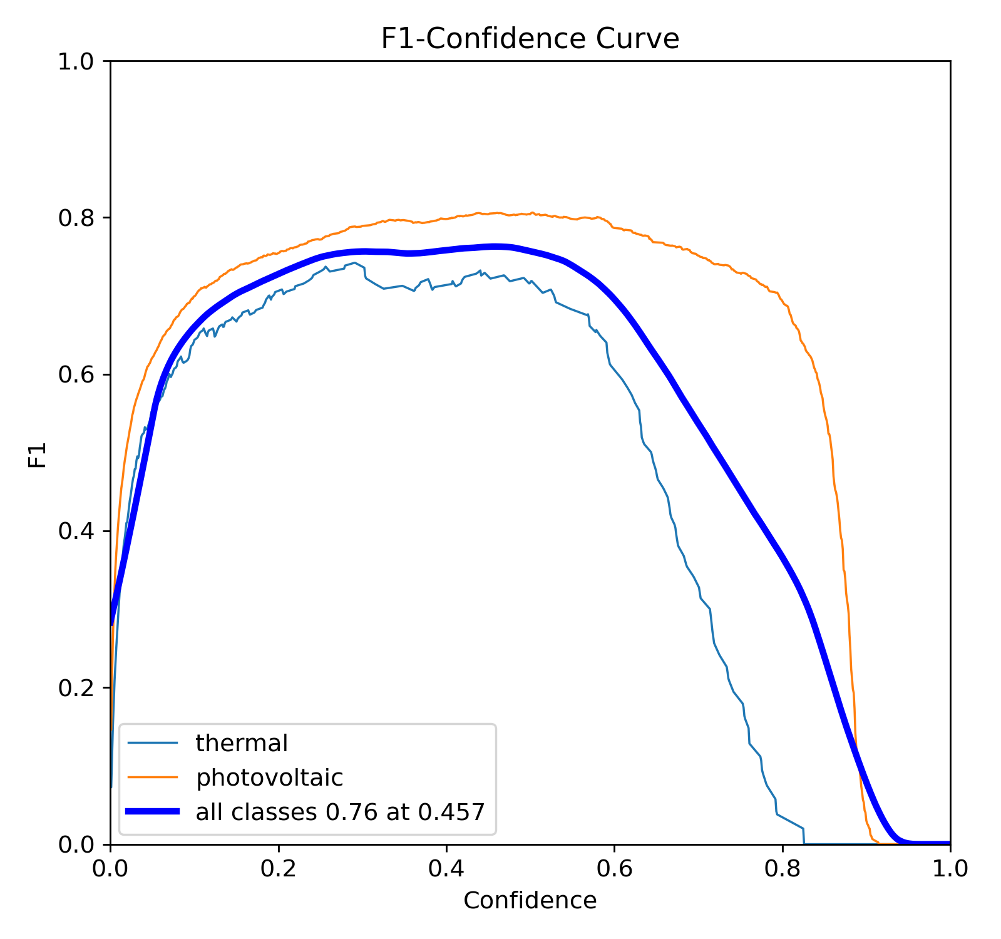
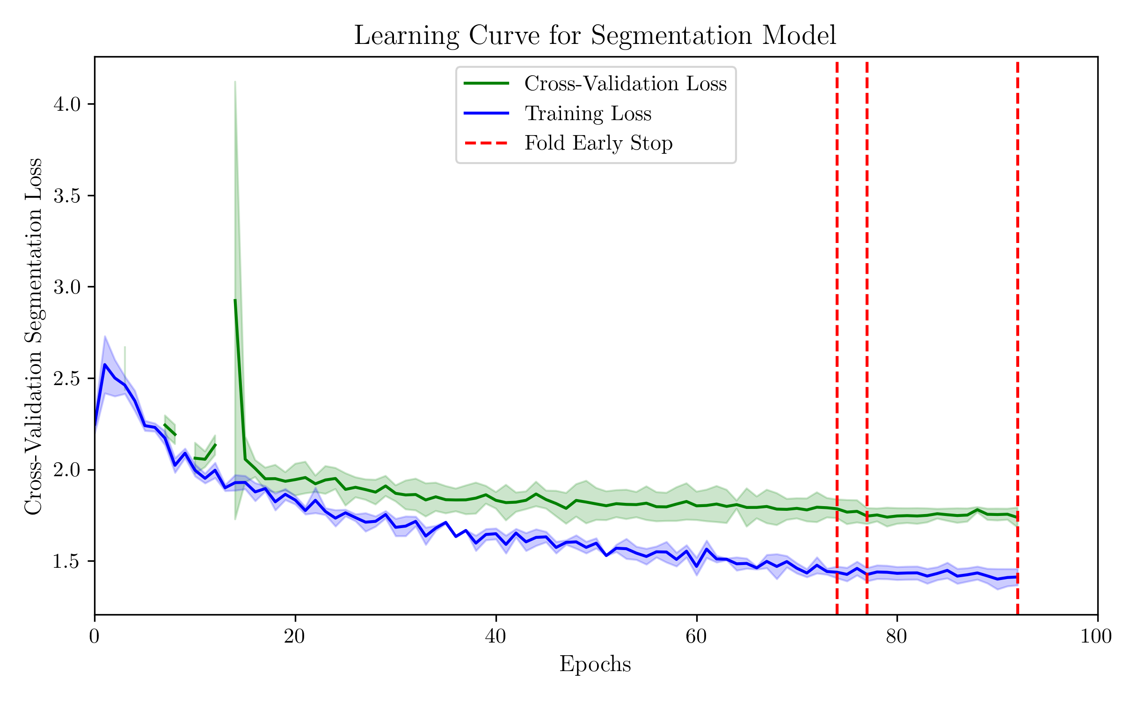
Instance segmentation - results
Error metrics

Slide 17
Results analysis

Slide 18
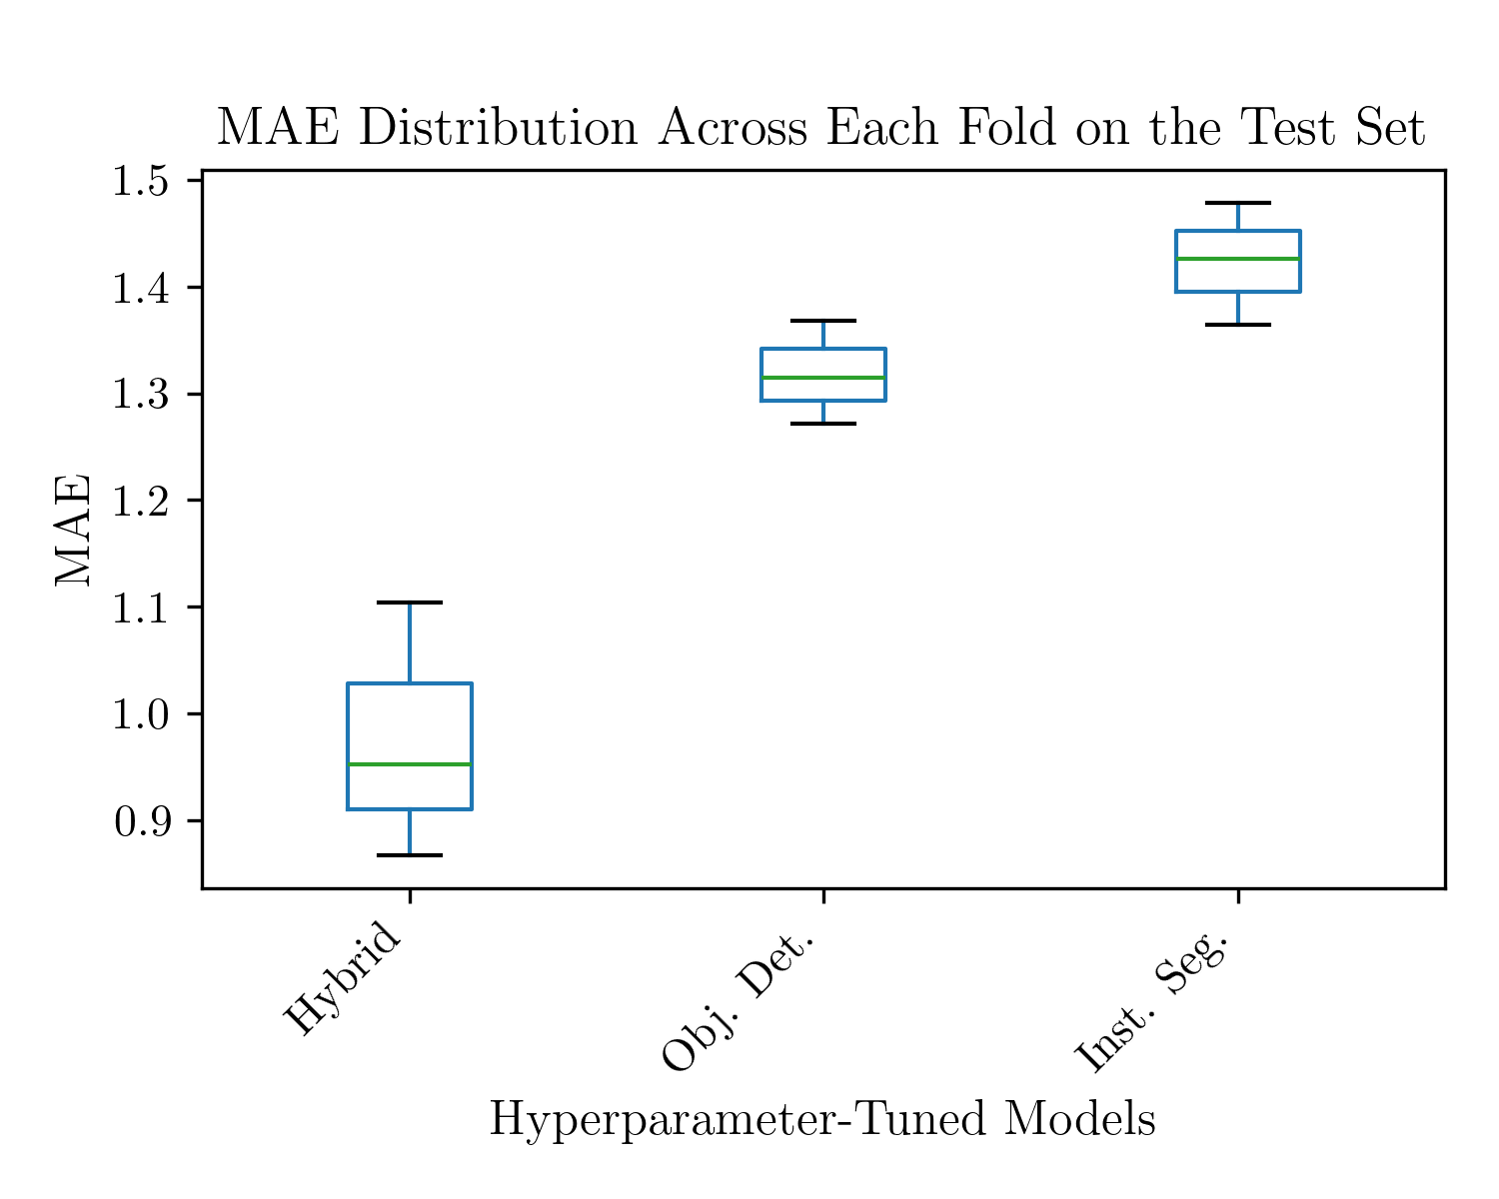
Results & BenchMark
Error metrics for the fine-tuned models along with the best performers in the competition

Slide 19
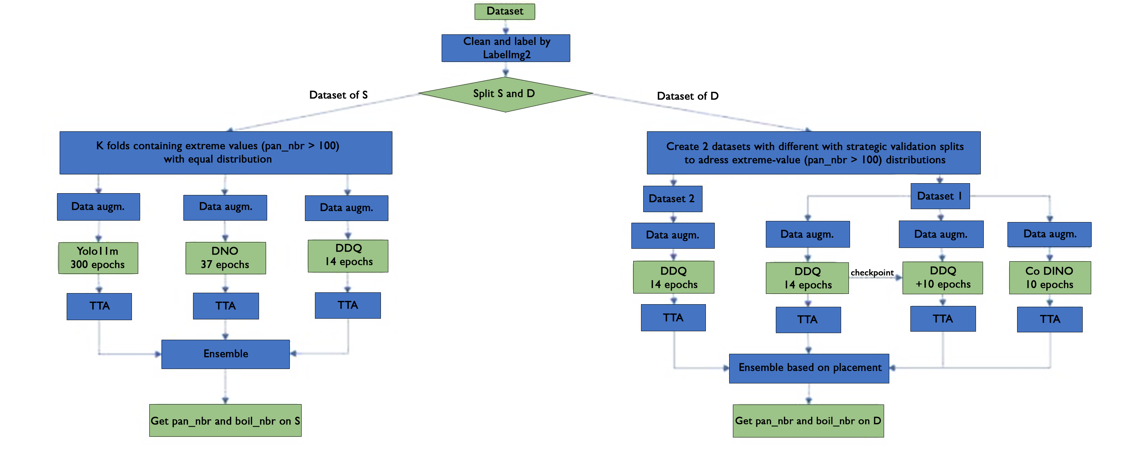
Team lacuna approach

Slide 20
conclusions
The goal of this project was to develop a model capable of detecting and counting photovoltaic and solar thermal panels in aerial imagery from drone and satellite sources.
Although the dataset initially presented several issues, such as mislabelled images, inaccurate masks, and class imbalance, it was refined through manual corrections and preprocessing.
Ultimately, the hybrid model demonstrated the best performance, among the evaluated models.

